Slide 1

Continual Learning Techniques for Image Classification
Finlay Boyle
Supervised by Dr Donald Sturgeon
Durham University, Department of Computer Science
Notes:
Continual Learning Techniques for Image Classification

Slide 2
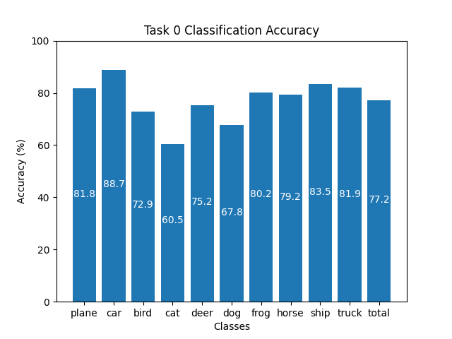
Training Machine Learning Models
Standard method of training models is known as Offline Training
Repeatedly optimise over batches of data from the dataset
Requires access to all of the data for the whole training process
Capable of producing high-quality results
Some limitations exist:
What if the data is not all readily available?
What if it is too expensive or infeasible to store all of the data?
Figure 1: Offline Training on CIFAR-10 for 100 epochs
Notes:
Currently, the standard method to train machine learning models to classify images is to split a dataset into batches and repeatedly pass these batches to the model. These batches of data are then used to optimise the parameters of the model via backpropagation on a loss function which is computed using the batched data. This is known as Offline Training.
Offline Training is capable of producing high quality results. For example, Figure 1 shows the classification accuracy of a ResNet-18 model trained for 100 epochs on the CIFAR-10 dataset, it attains an average classification accuracy of over 77%.
However, Offline Training has some limitations. If the data is not available in its entirety, for example it is real-time data, or it is too expensive to store it all then Offline Training can be difficult as it requires the whole dataset to be available at training time.
This raises the question: what happens if the network is just trained as data becomes available?

Slide 3
Catastrophic Forgetting
Catastrophic Forgetting: a phenomenon were a neural network overwrites any existing knowledge in the network when training on new data [1]
Occurs when naively using Offline Training to update an already trained neural network about new classes sequentially
Offline Training does not preserve the existing knowledge in the network
Training process does not have the context that the existing weights in the network represent prior knowledge
Can view them as an initialisation of the network instead
Inspiration for neural networks comes from nature [2] but ability to learn continuously is often overlooked
Notes:
Catastrophic Forgetting is a fe-nom-en-non that is caused by training an already trained model on new data. The model is unable to retain the knowledge that it has learnt previously leading it to complete overwrite this learnt knowledge. Offline Training is unable to preserve the existing knowledge in the network.

Slide 4
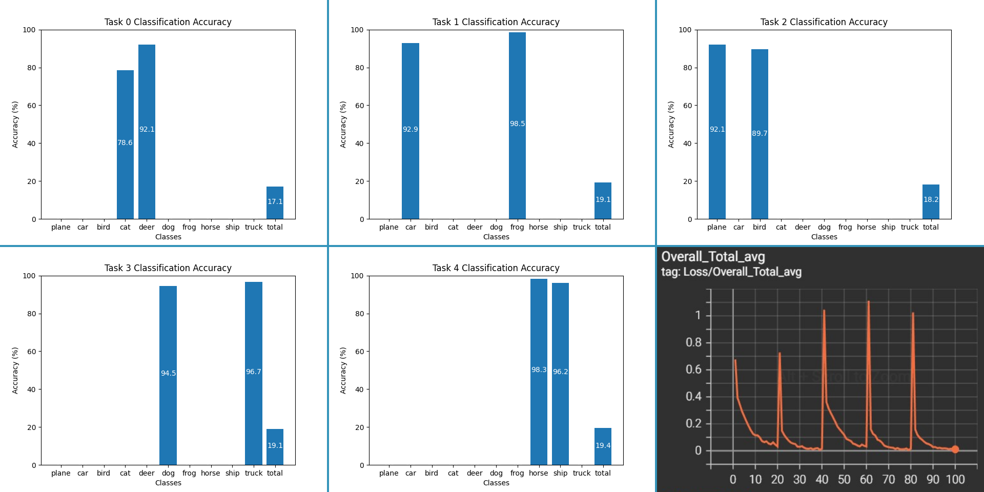
Example of Catastrophic Forgetting
Figure 2: Applying Offline Training on the same model with separate tasks causes Catastrophic Forgetting. Bottom right: Overall loss, other images are classification accuracy
Notes:
In this example, a ResNet-18 model is trained on CIFAR-10 that is split into 5 separate tasks each consisting of 2 classes. These tasks are used to train the model sequentially, each task is trained for 20 epochs. As you can see in the graphs for each task, the model forgets everything it has learnt about the previous tasks and overwrites the knowledge leading to a consistently low overall accuracy demonstrating catastrophic forgetting.
The final graph shows the loss peaking at the start of each task as knowledge is overwritten.

Slide 5
Continual Learning
Continual Learning attempts to overcome Catastrophic Forgetting [3]
Is it possible to train a network sequentially while maintaining knowledge?
Primarily focused on alternative methods to Offline Training
Smaller focus on network architecture and dynamic networks
Difficulty of the Continual Learning problem depends on the setup of the problem
Core difference from Offline Training is the removal of the requirement of the whole dataset
Rose to prominence with Elastic Weight Consolidation in 2017 [4] and is actively researched
Notes:
Continual Learning is the study of techniques to reduce the effect of Catastrophic Forgetting. The majority of the literature focuses on alternatives to Offline Training but there has been a recent interest into how the architecture of a model may contribute to forgetting.
The key thing that links everything in this field is lack of need for the entire dataset to be present at training time. Elastic Weight Consolidation was one of the first techniques that gave prominence to the idea of Continual Learning, this is an approach that penalises changes to weights that are important to previous tasks.

Slide 6
Applications of Continual Learning
Continual Learning offers real-world benefits
Models trained on massive amounts of data are expensive to train [5] in terms of energy usage, computational resources, and time
Retraining these models to update them with new data compounds the cost
If they can be updated with Continual Learning this could save computational resources and time such as in Image Classification [6]
Real-time applications can also benefit by adapting to the changing data distribution leading to more accurate results
Research is mainly focused on Image Classification but can be applied to other domains such as Natural Language Processing [7]
Notes:
It is also important to note the real-world applications of this area of research. Retraining models on new data to improve their accuracy is costly in terms of energy usage, computational resources, and time. Continual Learning offers a potential way to reduce these costs and provide training benefits.
It is also important to note that Image Classification is the main domain used for research, but the techniques can also be applied to other domains such as Natural Language Processing.

Slide 7
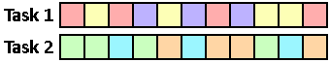
Setup for Continual Learning
The setup of the problem for Continual Learning is vital to ensure results are real-world applicable
Issues with the direction of the literature were highlighted by the authors of a simplistic technique called GDumb [8]
Assumptions affecting the setup:
Online vs Offline
Disjoint Tasks vs Non-Disjoint Tasks
Class Incremental vs Task Incremental
Resource Constraints
Figure 3: Disjoint Task Formulation with 3 classes per task
Figure 4: Non-disjoint Task Formulation with all 6 tasks in any order
Notes:
The setup of the Continual Learning problem is vitally important. This has been a key issue in the literature as highlighted by the authors of a technique known as GDumb. They argue that many techniques in the literature have too simplistic setups to be applicable to the real-world.
There are a few key factors affecting the difficulty of the problem. The first is Online vs Offline: Online assumes that the data is streamed continuously and not fixed unlike Offline Training, online is more realistic.
The structure of the tasks in the problem are also important. Disjoint task formulations partition the problem into tasks with distinct classes without overlap. Overlapped tasks are more real-world applicable and examples of these can be seen in Figures 2 and 3 with the colours representing different classes.
Task identification also plays a large role in some techniques. Techniques under the Task Incremental formulation use the disjoint task but importantly the model is told which task a sample belongs to at classification time greatly simplifying the problem. Class Incremental can use either disjoint or overlapping but the preferred formulation is to have a single task where classes can begin to appear at any time and then stop appearing at any time in the future.
Furthermore, it is important to impose limits on the resource consumption of the techniques to ensure that they are not using drastic amounts of resources in exchange for performance.

Slide 8
Part I: Literature Evaluation
My project will initially focus on implementing and evaluating existing techniques from the literature
Aim is to provide a robust comparison between existing methods to solve some of the issues outlined previously
Deliverables:
Implementation of Baselines: Finetuning and Offline Training
Historical Techniques: Elastic Weight Consolidation [4], iCaRL [9]
State of the Art: GDumb [8], Rainbow [10], Mnemonics [11]
Cutting Edge: Learning to Prompt [12] and meta-learning techniques
Evaluation and comparison of techniques
Notes:
Initially, the focus of my project will be on implementing and comparing techniques from the literature. As mentioned before, the setup and comparison of techniques has been an issue within the literature.
This will start with implementation of the baselines: Offline Training and Finetuning, which is similar to the catastrophic forgetting example shown earlier and represents the lower bound. The goal is to match Offline Trainings results.
After this, I will implement historical techniques such as Elastic Weight Consolidation.
Following this, I will implement the current state of the art such as GDumb, a method that stores a subset of data and trains a classifier at inference time, Rainbow, another method that samples data that is representative of its own class and discriminative against others, and Mnemonics which is a similar sampling technique.
Finally, I will implement cutting edge techniques that are presenting new ideas such as Learning to Prompt, a technique that learns small inputs to be prepended to the input prior to classification, and meta-learning techniques that learn how to preserve knowledge during training.

Slide 9
Part II: Novel Experimentation
After literature comparison and evaluation, the focus will shift to gaps in the literature
Aim is to experiment with potential future research areas and potentially create a novel approach.
This will be influenced by the cutting-edge techniques e.g. experimenting with architecture [13] and sampling methods for replay methods
Deliverables:
Establishing a theoretical underpinning to any experimentation to ensure there exists potential
Implementation of experiments and potentially any different approaches found
Evaluation and comparison with techniques from Part I
Notes:
After this, I will focus on experimenting with gaps in the literature with the aim to contribute something novel to the field. This will be influenced by the cutting-edge techniques as well as potentially experimenting with the architecture of the model. This will involve explaining and understanding the theory behind techniques, implementing these ideas and comparing them to existing techniques.

Slide 10
References
[1] McCloskey, Michael, and Neal J. Cohen. "Catastrophic interference in connectionist networks: The sequential learning problem." Psychology of learning and motivation. Vol. 24. Academic Press, 1989. 109-165.
[2] Hecht-Nielsen, Robert. "Neurocomputing: picking the human brain." IEEE spectrum 25.3 (1988): 36-41.
[3] Parisi, German I., et al. "Continual lifelong learning with neural networks: A review." Neural Networks 113 (2019): 54-71.
[4] Kirkpatrick, James, et al. "Overcoming catastrophic forgetting in neural networks." Proceedings of the national academy of sciences 114.13 (2017): 3521-3526.
[5] Wiggers, Kyle. "AI Weekly: AI Model Training Costs on the Rise, Highlighting Need for New Solutions." VentureBeat, 15 Oct. 2021, https://venturebeat.com/ai/ai-weekly-ai-model-training-costs-on-the-rise-highlighting-need-for-new-solutions/.
[6] Mai, Zheda, et al. "Online continual learning in image classification: An empirical survey." Neurocomputing 469 (2022): 28-51.
[7] Biesialska, Magdalena, Katarzyna Biesialska, and Marta R. Costa-Jussa. "Continual lifelong learning in natural language processing: A survey." arXiv preprint arXiv:2012.09823 (2020).
[8] Prabhu, Ameya, Philip HS Torr, and Puneet K. Dokania. "Gdumb: A simple approach that questions our progress in continual learning." European conference on computer vision. Springer, Cham, 2020.
[9] Rebuffi, Sylvestre-Alvise, et al. “iCaRL: Incremental classifier and representation learning." Proceedings of the IEEE conference on Computer Vision and Pattern Recognition. 2017.
[10] Bang, Jihwan, et al. "Rainbow memory: Continual learning with a memory of diverse samples." Proceedings of the IEEE/CVF Conference on Computer Vision and Pattern Recognition. 2021.
[11] Liu, Yaoyao, et al. "Mnemonics training: Multi-class incremental learning without forgetting." Proceedings of the IEEE/CVF conference on Computer Vision and Pattern Recognition. 2020.
[12] Wang, Zifeng, et al. "Learning to prompt for continual learning." Proceedings of the IEEE/CVF Conference on Computer Vision and Pattern Recognition. 2022.
[13] Mirzadeh, Seyed Iman, et al. "Architecture matters in continual learning." arXiv preprint arXiv:2202.00275 (2022).

